Slide 1
Teknologi dan Aplikasi Artificial Intelligence
Pertemuan ke-2

Slide 2

Profil Pengajar: Dr.Eng. I Putu Agung Bayupati, S.T., M.T.
Poto Pengajar
Jabatan Akademik: Lektor
Latar Belakang Pendidikan:
S1: Prodi Teknik Elektro – Fakultas Teknik – UNUD
S2: STEI – Teknologi Informasi - ITB
S3: Division of Electrical Engineering and Computer Science - Kanazawa University
Riwayat/Pengalaman Pekerjaan:
Dosen (2003)
Web designer CV.Synergy Interactive Marketing (www.syn-i.com) (2002)
Editor dan Web designer balifolder.com (2001)
Contak Pengajar:
Ponsel:
08123619110
Email:
bayupati@unud.ac.id
2

Slide 3

SUMBER UTAMA MATERI
Sumber berupa slide materi:
Materi Kuliah Artificial Intelligence di Informatika ITB
Berbagai Pelatihan di Pusat AI ITB
Sumber berupa buku:
Stuart J Russell & Peter Norvig, “Artificial Intelligence: A Modern Approach”, 3rd Edition, Prentice-Hall International, Inc, 2010
Ayu Purwarianti, Bambang Riyanto, Dessi Puji Lestari, Intan Muchtadi Alamsyah, Nugraha Priya Utama, Ridwan Sutriadi, Sapto Wahyu Indratno, Sophi Damayanti, “Artificial Intelligence di Masa Pandemi”, ITB Press, 2021
Penyusun Sumber Materi:
Dwi Hendratmo Widyantoro
Masayu Leylia Khodra
Nur Ulfa Maulidevi
Dessi Puji Lestari
Windy Gambetta
Nugraha Priya Utama
Ayu Purwarianti
Contact Penyusun
Pusat AI ITB
Ponsel : +62 815-6322-2235
Email : aicenter@itb.ac.id

Slide 4
4
Learning Objective
Peserta mampu menjelaskan konsep dasar AI dengan benar dan mengidentifikasi pemanfaatan teknologi AI
Course SubTopics
Definisi Artificial Intelligence
Perancangan Intelligent Agent
Jenis Teknologi Artificial Intelligence
Perkembangan Teknologi Artificial Intelligence
Penerapan Teknologi Artificial Intelligence
Tantangan dalam Pengembangan Teknologi Artificial Intelligence

Slide 5
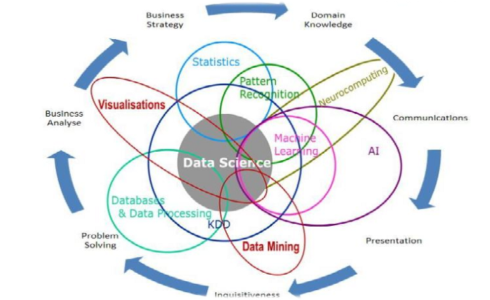
Data Science dan Artificial intelligence

Slide 6


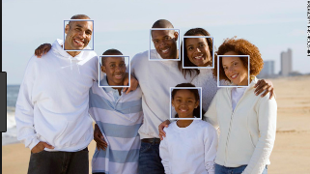


ARTIFICIAL INTELLIGENCE, IS IT A HYPE?
Text Processing
Image Processing
Facebook Face Recognition
Speech Processing

Slide 7

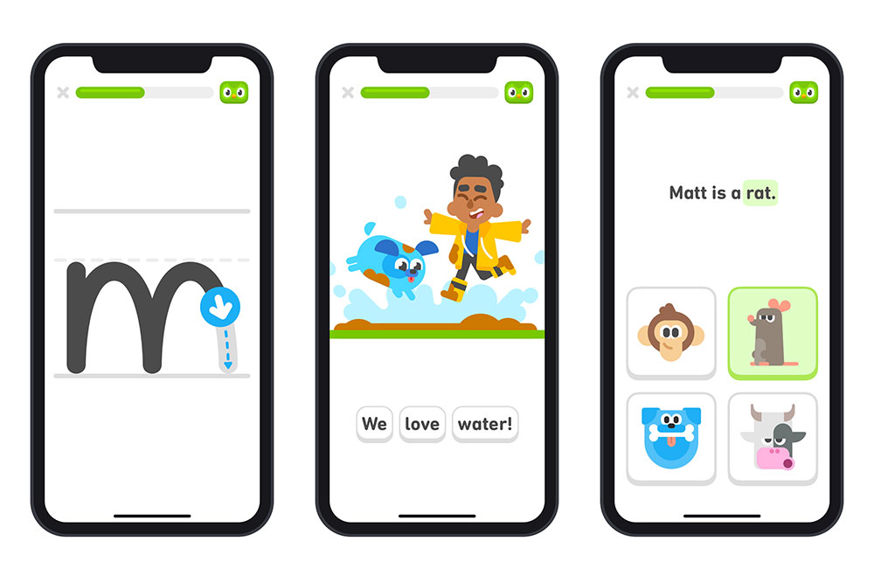
AI di Dunia Nyata: Belajar Bahasa Dunia Duolingo
Belajar Bahasa meningkat saat pandemik
300 juta pengguna, 30 juta pengguna aktif/bulan
Belajar bahasa berbasis game
Ref: How Duolingo uses AI in every part of its app (venturebeat.com)

Slide 8
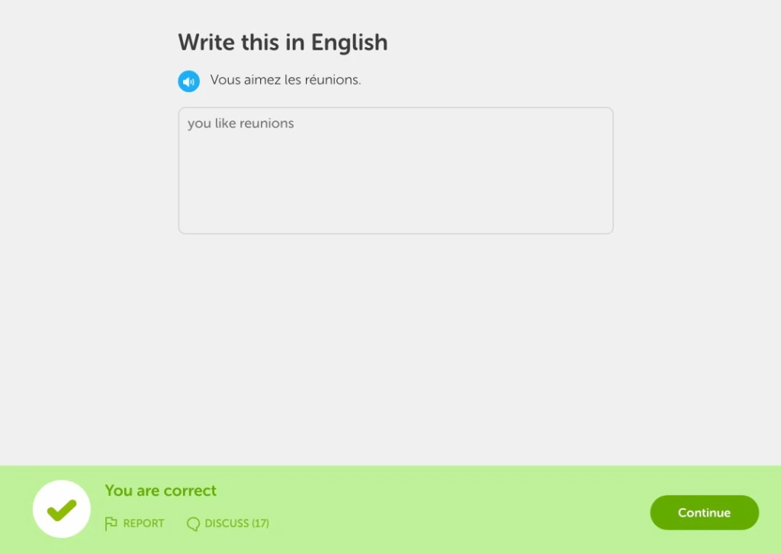
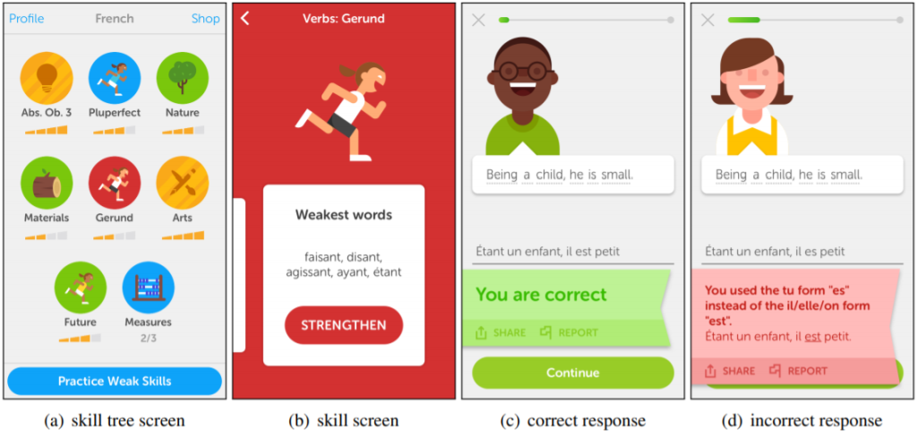
AI di Dunia Nyata: Belajar Bahasa Dunia Duolingo
Fitur Birdbrain: Machine Learning based
Fitur Spaced Repetition
Membangun profil yang sangat rinci berdasarkan apa yang Anda ketahui dan apa yang tidak Anda ketahui
Model ini dapat memprediksi kapan Anda lupa sesuatu karena Anda belum sering melihatnya, atau baru-baru saja melihatnya. Ini untuk membantu memilih tantangan mana yang akan dimasukkan ke dalam sesi latihan user.

Slide 9
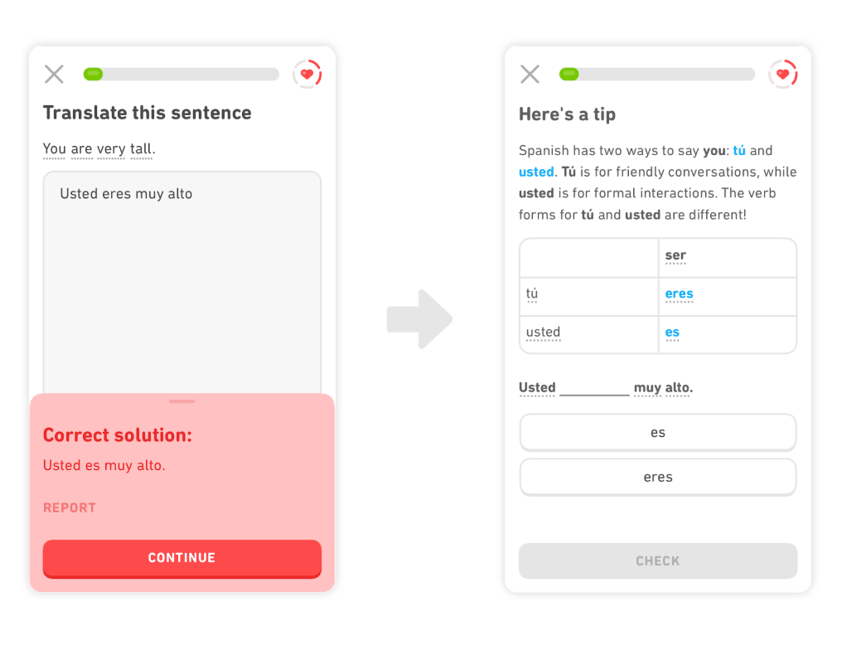
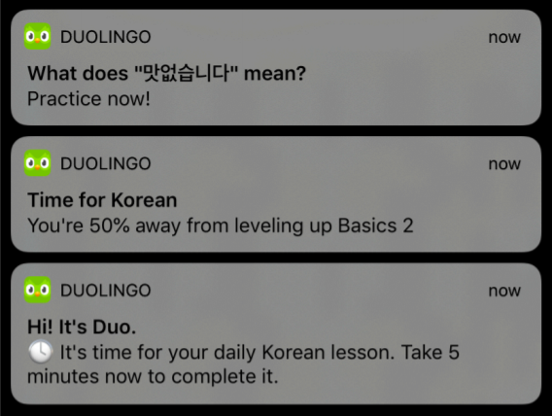
AI di Dunia Nyata: Belajar Bahasa Dunia Duolingo
Fitur Active Learning: NLP based
Fitur Bandit Algorithm
Misalnya, jika Duolingo memperhatikan bahwa Anda memasukkan kata-kata yang tepat tetapi dalam urutan yang salah, itu dapat memberi Anda tip tata bahasa korektif tepat setelah meludah bahwa input Anda salah.
Melatih seluruh sistem mencoba untuk mencari tahu kapan waktu terbaik untuk mengirim pemberitahuan berdasarkan aktivitas Anda sendiri

Slide 10
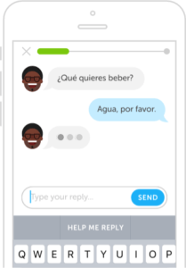
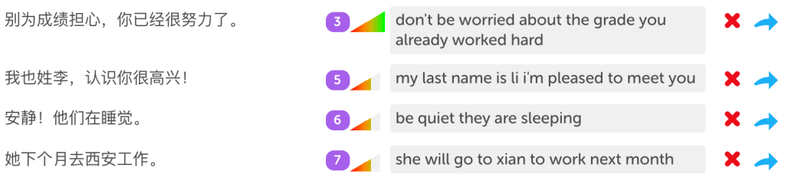
AI di Dunia Nyata: Belajar Bahasa Dunia Duolingo
Fitur Logistic Regression
Fitur Chatbots
Setiap kali User mengirimkan jawaban atas tantangan dan Duolingo mengatakan user salah, dan memiliki opsi untuk menekan tombol Laporkan. Jika User berpikir melakukannya dengan benar, maka dapat mengajukan banding.
Menawarkan percakapan dalam skala besar hingga 300 juta pengguna dalam 94 bahasa yang berbeda? Gunakan chatbot basis AI

Slide 11
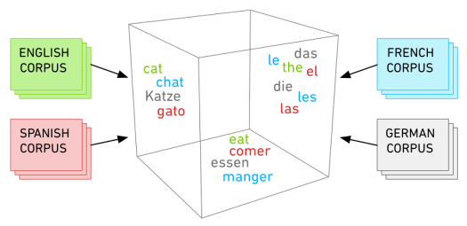
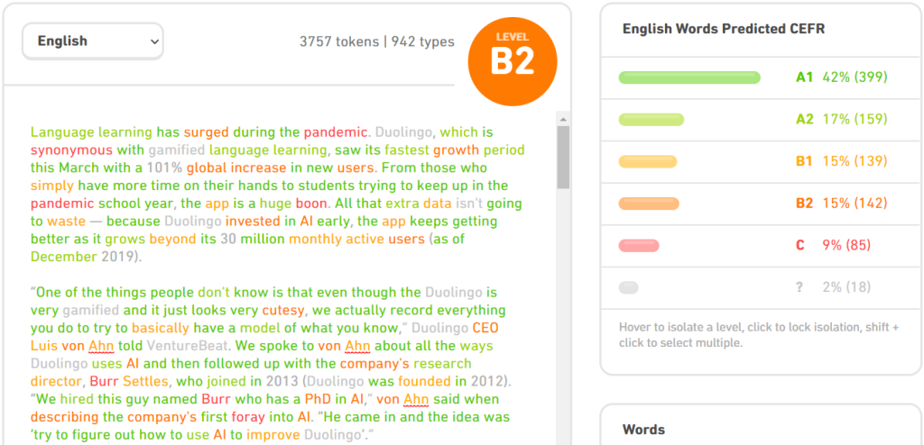
AI di Dunia Nyata: Belajar Bahasa Dunia Duolingo
Fitur CEFR checker
Duolingo menggunakan machine learning unsupervised untuk membangun alat untuk menentukan kesulitan teks apa pun untuk pelajar bahasa. Tim menggunakan Common European Framework of Reference (CEFR), yang memiliki skala enam tingkat: A1 dan A2 (pemula), B1 dan B2 (menengah), dan C1 dan C2 (lanjutan).

Slide 12
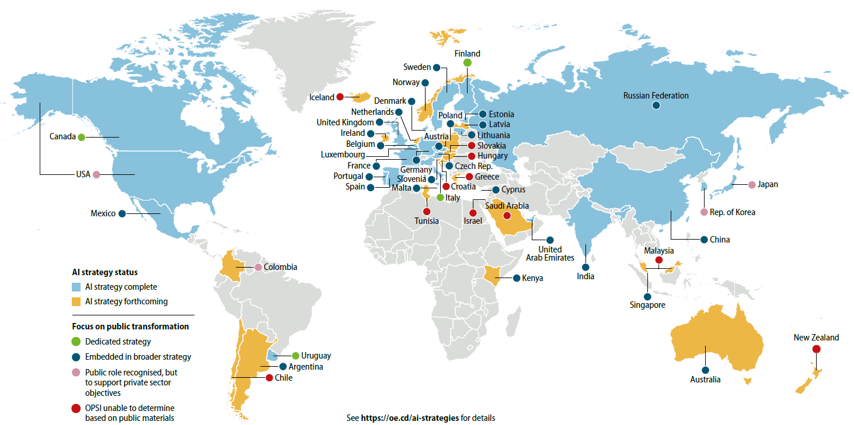
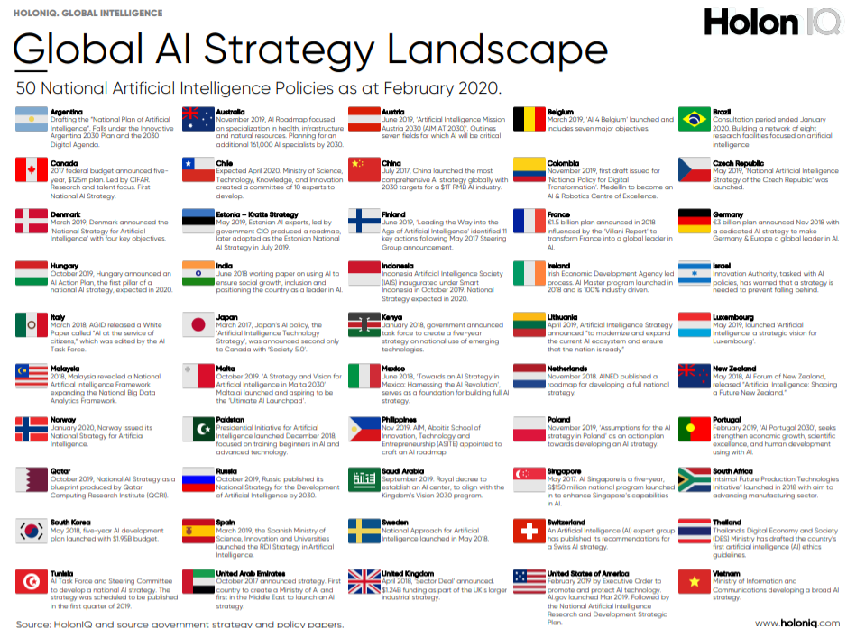
AI Di Berbagai Negara

Slide 13
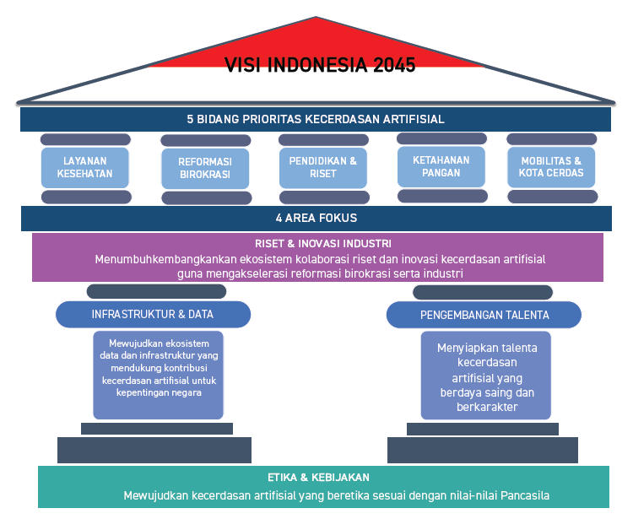
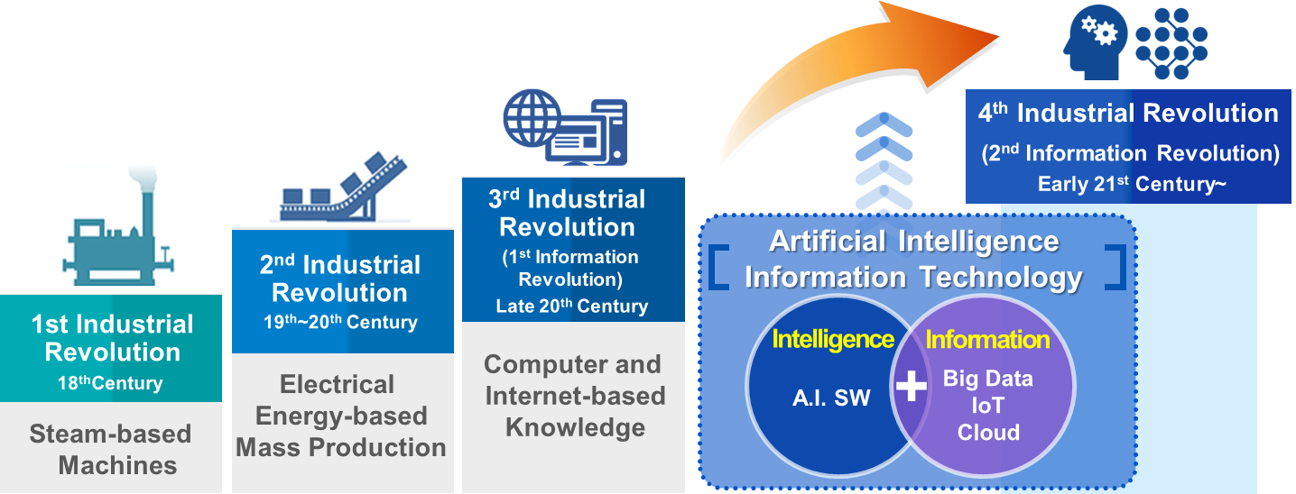
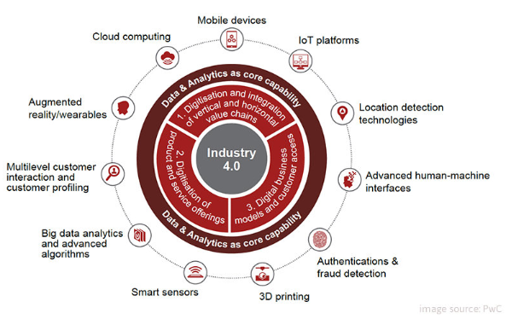
Arahan Teknologi Artificial Intelligence di Indonesia
Strategi Nasional Kecerdasan Artifisial

Slide 14
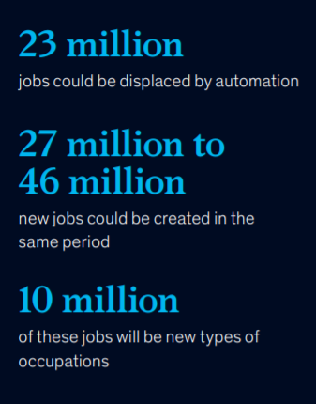
AI sebagai Disruptive Technology
McKinsey: Sept 2019
Automation Effect in Indonesia:
Pekerjaan yang digantikan oleh teknologi Kecerdasan Buatan adalah pekerjaan yang berulang dan dapat dengan mudah diprediksi. Sebagian besar Teknologi AI bertujuan untuk membantu pekerjaan manusia
Industri di Indonesia sudah mulai menggunakan teknologi AI untuk menekan biaya, meningkatkan pendapatan, memberikan nilai tambah pada produk

Slide 15
Artificial Intelligence Agent
Artificial Intelligence
Cloud Computing
Agent
Big Data
Percept
Action
IoT
Environ-ment

Slide 16
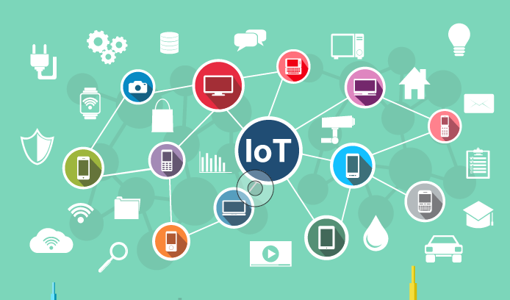
Internet of Things
Definisi:
Peralatan/gadget sehari-hari atau objek yang terhubung dengan Internet dan memiliki kemampuan untuk mengumpulkan dan mengirimkan data
Contoh IoT pada keseharian/rumah dalam bentuk smart consumer goods: smart bulb, smart light switch, smart doorlock, smart watch, smartphone, fitness tracker, smart tv, smart thermostat, smart toilet, smart bike lock dll.

Slide 17
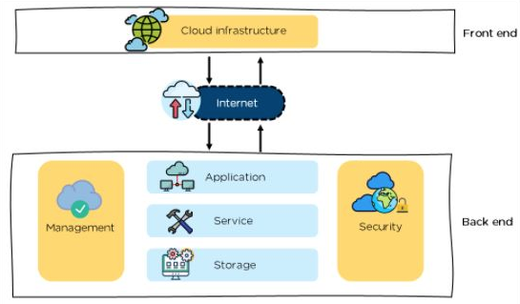
Cloud & Edge Computing
Menyimpan dan memproses data di komputer (datacenter) orang lain melalui jaringan Internet
Pemrosesan data di peralatan seperti smartphone (yang saat ini semakin powerful)
Sudah banyak dipakai di kehidupan sehari-hari
Saat mengakses e-mail berbasis Web (misal Gmail)
Saat upload foto/video di Facebook/Youtube/Google Drive
Saat menggunakan Office 365, Google Doc
Saat order gojek atau booking hotel lewat apps di smartphone
Untuk bisnis, platform untuk consumer services, inventory management, recruiting & HR, design, retail dan shipping (oleh cloud provider kebanyakan sudah disediakan sebagai “software-as-a-service”)
https://www.simplilearn.com/tutorials/cloud-computing-tutorial/cloud-computing-architecture

Slide 18





Big Data
Data Mining
Data Warehouse
AI - Machine Learning
1900
1980
1990
2000
Today
18

Slide 19
Big Data
High-volume, high-velocity, and/or high-variety information assets
Require new forms of processing: capture, curation, storage, search, sharing, transfer, analysis, visualization
To enable:
enhanced decision making
insight discovery
and process optimization
Karakteristik Big Data
Velocity: kecepatan data yang dihasilkan (per detik, per menit, per jam, per hari, dst).
Volume: jumlah data yang diakumulasikan (terabyte, petabyte, exabyte, zettabye, yottabyte dst)
Variety: jenis/ragam data yang bermacam-macam: terstruktur, semi-terstruktur, tidak terstruktur (teks, suara, gambar, video dll)
Veracity: kesesuaian dengan fakta dan akurasi (khususnya dari data tidak terstruktur)
Value: kemampuan untuk mengubah data ke value (profit, manfaat medis & social, customer satisfication)

Slide 20






Ekosistem Big Data
Data Sources
Acquisition
and Storage
Consumption
Analytics
Streaming
Distributed
Storage
Statistik Data
Pola
(korelasi, asosiasi)
Reasoning
Machine Learning
NLP
Speech
Vision
ERP, CRM, OLAP
Batch
20

Slide 21
Analytics on Data
Descriptive:
Menjelaskan keadaan bisnis saat ini melalui data historis.
01
02
Diagnostic:
Menjelaskan mengapa suatu masalah terjadi dengan melihat data historis.
Predictive:
Memproyeksikan atau memprediksi hasil masa depan
berdasarkan data historis.
03
Prescriptive:
Menggunakan hasil analitik prediktif dan pengetahuan lain
dengan menyarankan upaya terbaik di masa depan.
04

Slide 22
Definisi Artificial Intelligence
Thinking Humanly “The exciting new effort to make computers think.. Machines with minds, in the full and literal sense” (Haugeland, 1985) “[The automation of] activities that we associate with human thinking, activities such as decision making, problem solving, learning …” (Bellman, 1978) | Thinking Rationally “The study of mental faculties through the use of computational models.” (Charniak and McDermott, 1985) “The study of the computations that make it possible to perceive, reason, and act.” (Winston, 1992)
Acting Humanly “The art of creating machines that perform functions that require intelligence when performed by people.” (Kurzweil, 1990) “The study of how to make computers do things at which, at the moment, people are better.” (Rich and Knight, 1991) | Acting Rationally “Computational Intelligence is the study of the design of intelligent agents.” (poole et al., 1998) “AI .. Is concerned with intelligent behavior in artifacts.” (Nilsson, 1998)

Slide 23
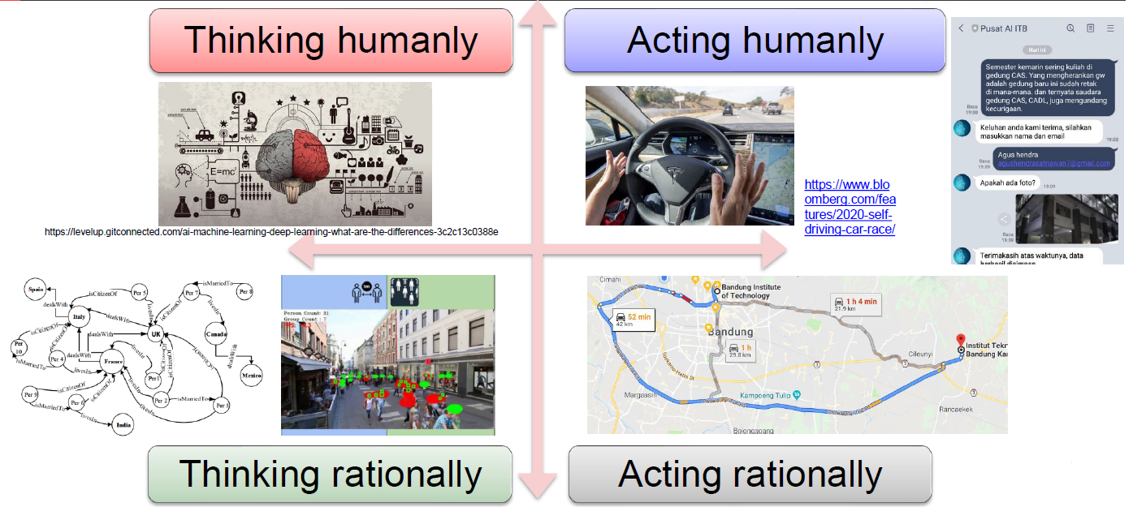
Definisi Artificial Intelligence (2)

Slide 24
Intelligent Agent
Merancang PEAS:
Performance/Pengukuran performansi: aman, cepat, tidak melanggar aturan lalu lintas, kenyamanan penumpang
Environment/Lingkungan: jalan, rambu-rambu lalu lintas, kendaraan lain, penumpang
Actuator: kemudi, gas, rem, klakson
Sensor: kamera, sonar, speedometer, GPS
Agent
Percept
Action
Environ-ment

Slide 25
Environment Type
Fully observable (vs. partially observable) | An agent's sensors give it access to the complete state of the environment at each point in time.
Deterministic(vs. stochastic) | The next state of the environment is completely determined by the current state and the action executed by the agent. (If the environment is deterministic except for the actions of other agents, then the environment is strategic)
Episodic (vs. sequential) | The agent's experience is divided into atomic "episodes" (each episode consists of the agent perceiving and then performing a single action), and the choice of action in each episode depends only on the episode itself

Slide 26
Environment Type (2)
Static (vs. dynamic) | The environment is unchanged while an agent is deliberating.
Discrete(vs. continuous) | A limited number of distinct, clearly defined percepts and actions.
Single agent(vs. multiagent) | An agent operating by itself in an environment
Known(vs Unknown) | This distinction refers not to the environment itself but to the agent’s (or designer’s) state of knowledge about the “laws of physics” of the environment

Slide 27
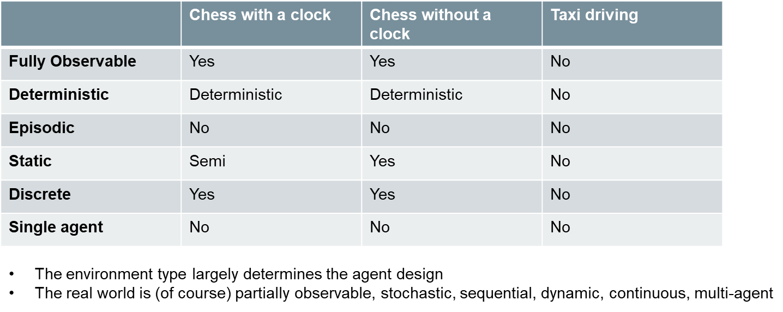
Example on Environment Type

Slide 28
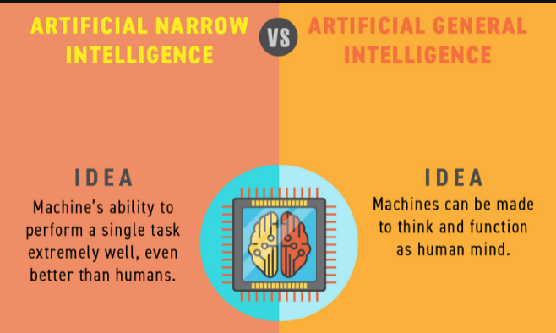
Pembagian Jenis Teknologi Artificial Intelligence (1)
Berdasar task scope:
Artificial Narrow Intelligence (ANI) – weak AI: teknologi AI yang ditujukan untuk melakukan satu task khusus
Contoh: chatbot pemesanan tiket pesawat, klasifikasi jenis penyakit kulit
Artificial General Intelligence (AGI) – strong AI: teknologi AI yang bisa menangani semua task yang dilakukan manusia
Sumber gambar: analyticsindiamag.com

Slide 29
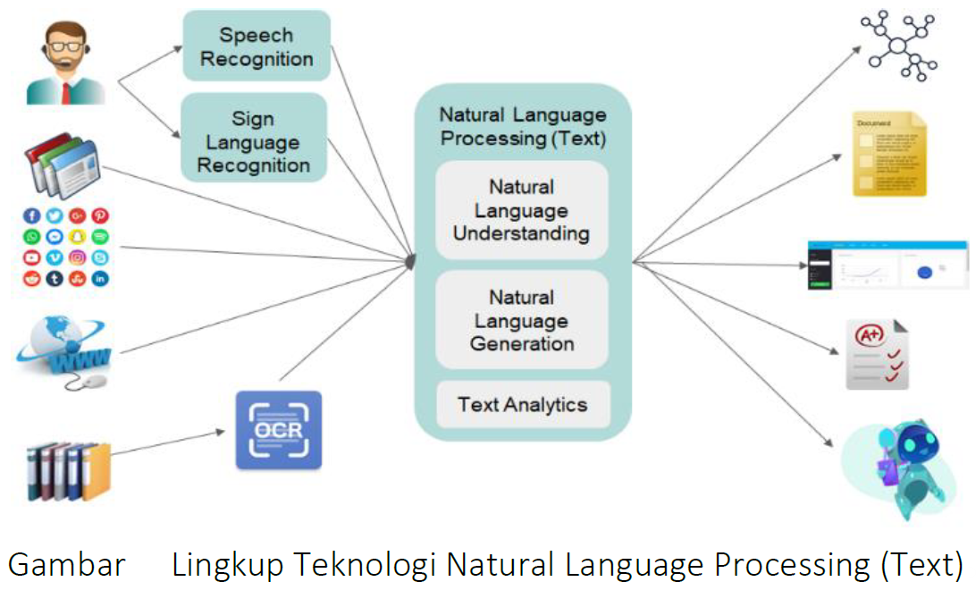
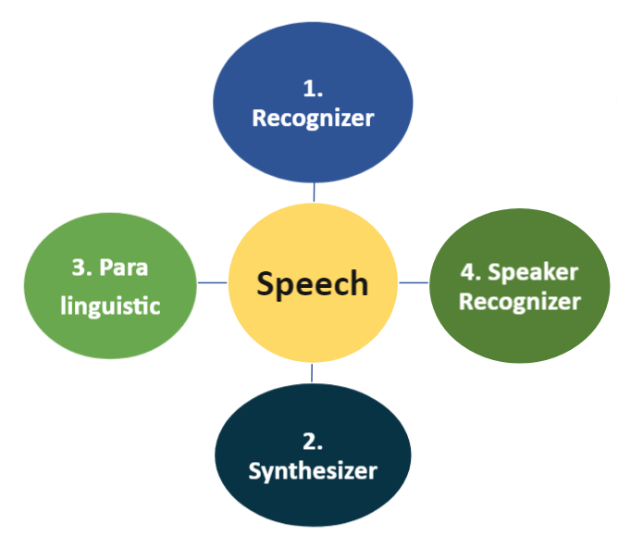
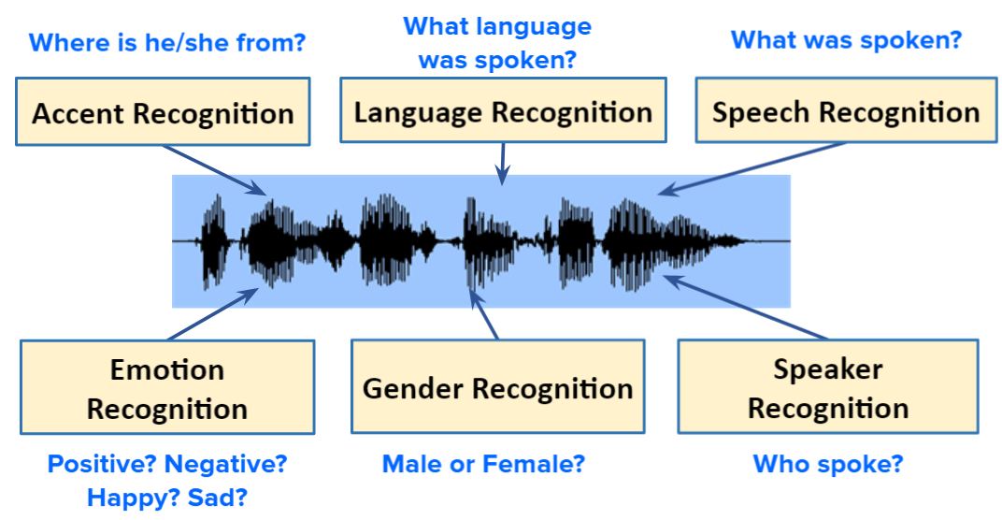
Pembagian Jenis Teknologi Artificial Intelligence (2)
Berdasar domain persoalan:
Teknologi AI juga dapat dibagi menjadi cabang-cabang domain persoalan yang diselesaikan, contohnya: Natural language processing (input/output berupa Bahasa), Speech Processing (input/output berupa sinyal suara), Image Processing/Computer Vision (input/output berupa gambar), dst

Slide 30
Pembagian Jenis Teknologi Artificial Intelligence (3)
Berdasar prinsip kerja dalam teknologi AI:
Problem solving agent
Solution state space sudah terdefinisi, agent bertugas mencari solusi terbaik dari solution state space tersebut
Diselesaikan menggunakan searching algorithm
Knowledge based agent
Solution state space belum terdefinisi (non deterministic)
Agent mencari solusi berdasar knowledge yang dimiliki dimana knowledge dapat berasal dari expert/sumber informasi atau berdasar knowledge yang dipelajari (learning agent) dari data

Slide 31
Problem Solving Agent
Agent design:
formulate problem 🡪 search solution 🡪 execute
Task Environment: Remember PEAS
Problem: satisfy goal (goal state)
Agent task: find out which sequence of actions will get it to a goal state
4 components of a problem: initial state, operator/successor function, goal test, path cost
Searching: process of looking for sequence of action
Solution: sequence of action to goal state
Agent knows world dynamics
World states, actions
[when agent doesn’t know 🡪 learning]
World state is finite, small enough to enumerate
[ when state is infinite 🡪logic]
World is deterministic
[when non-deterministic 🡪uncertainty]
Agent knows current state
[when agent doesn’t know 🡪 logic, uncertainty]
Utility for a sequence of states is a sum over path

Slide 32
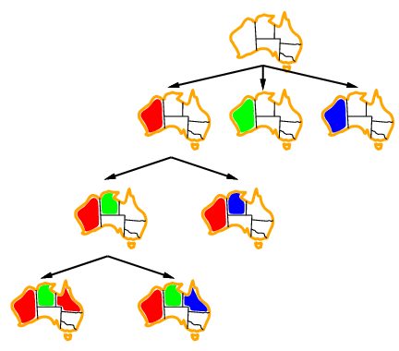
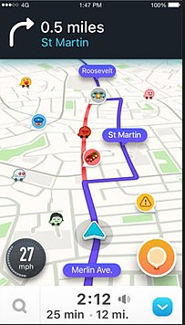
Contoh Persoalan pada Problem Solving Agent
O
71
151
S
99
F
Z
75
211
A
140
90
R
97
P
B
120
118
101
D
M
75
146
138
T
111
L
70
C
Map Coloring
Route Planning

Slide 33
Searching Algorithm pada Problem Solving Agent
UnInformed/Blind Search
Look around, don’t know where to find the right answer
No additional information beyond that provided in problem definitional
Example: DFS, BFS, IDS, UCS , DLS
Informed Search
Heuristic Search
Know some information that sometimes helpful
Know whether one non-goal state is “more promising” than another
Example: Best FS, A*,
Local Search (for Optimization Problem) 🡪 Beyond Classical Search
Path to goal is irrelevant
Use very little memory
Can find reasonable solutions in large or infinite state spaces for which systematic algorithms are suitable
Example: Hill-climbing search, simulated annealing search, GA

Slide 34
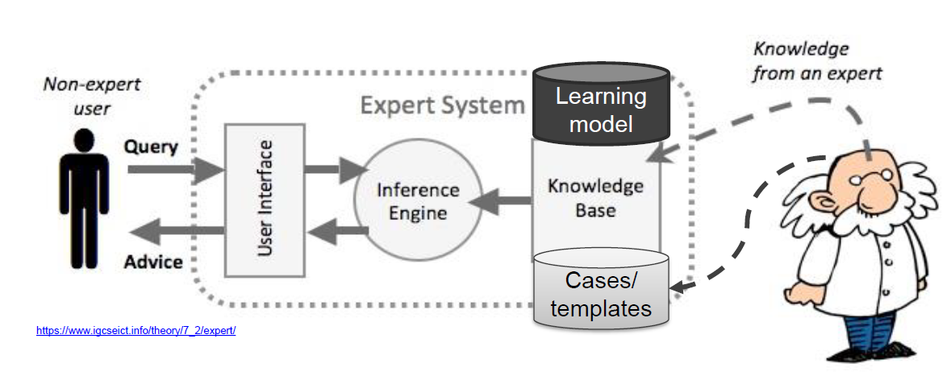
Knowledge based Agent

Slide 35
KBS vs Conventional Program
KBS | Conventional Program
ill structured problem (uncertain solution, undefined goal, unknown operator) | well structured problem (exact/certain solution, explicit goal, explicit operator)
expert determine actions, but execution order by interpreter | programmer determines actions and execution order
problem solving method + domain knowledge + data | algorithm + data

Slide 36
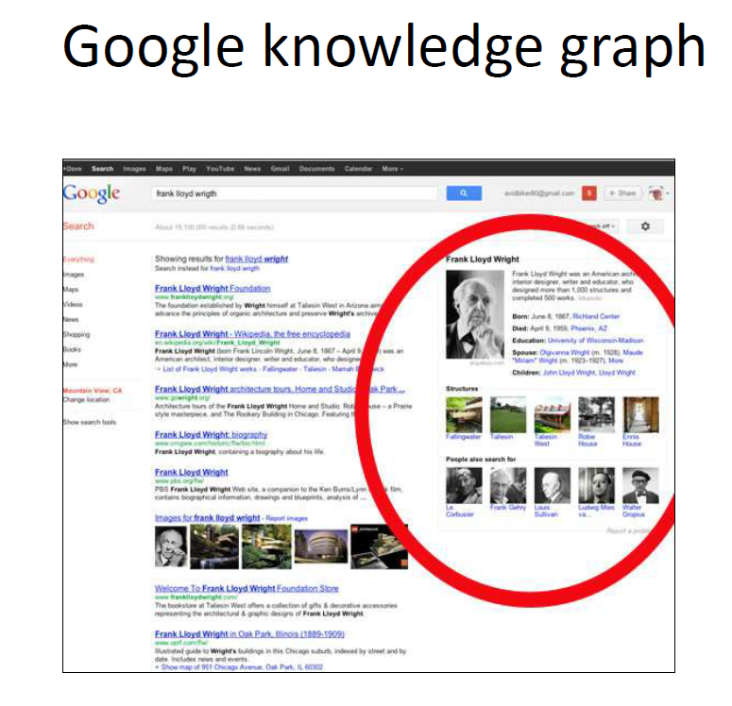
Pendekatan pada KBS
Symbolic vs Statistical
Statistical 🡪 speech recognition, vision
Why symbolic still needed?
Explanation
Planning
Diagnosis
Many AI systems are hybrid:
Watson
SIRI

Slide 37
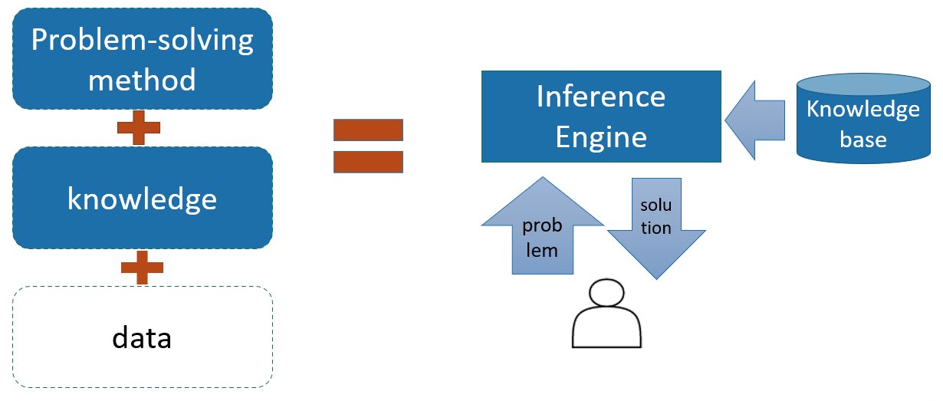
Alur Proses dalam KBS
data
learning

Slide 38
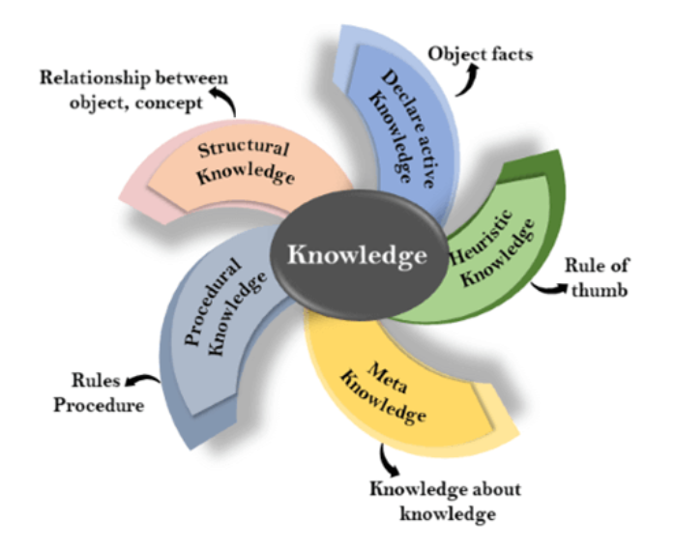
Symbolic based KBS: Knowledge Type
Declarative knowledge
Know about something: concepts, facts, objects
Also called descriptive knowledge
Procedural knowledge
Knowing how to do something: rule, strategy, procedure, agenda
Also known as imperative knowledge
Meta knowledge
Knowledge about other type of knowledge
Heuristic knowledge
Representing knowledge in a field/subject
Rules of thumb based on previous experience, good to work but not guaranteed
Structural knowledge
Describe relationship between concepts such as kind-of, part-of, group of something

Slide 39
Symbolic based KBS: Knowledge Representation Technique
Production Rules
rule as condition and action pair
forward & backward chaining
Logical Representation
propositional logic, first order logic, default logic, etc
Semantic Networks
knowledge as a form of graphical networks
Frame Representation
As structure consists of collection of attributes and its values to describe an entity in the world

Slide 40
Statistical based Knowledge Based System
Learning Agent
Changes in the system that are adaptive in the sense that they enable the system to do the task or tasks drawn from the same population more efficiently and more effectively the next time
Why need learning?
Learning is essential for unknown environment
i.e., when designer lacks omniscience, agent doesn’t know world dynamic
Learning is useful as a system construction method
i.e., expose the agent to reality rather than trying to write it down
Learning modifies the agent’s decision mechanism to improve performance
Learning from observations, feedback for improving the agent’s ability to act in the future

Slide 41
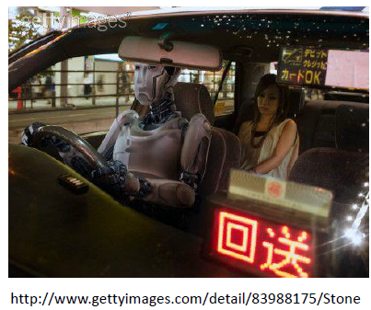
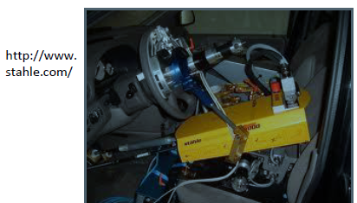
Taxi Driver as Learning Agent
Brake decision
Whether to push the brake or not based on the current state
Feedback: instructor shouts
Buses recognition
Input: image from camera
Output: whether it is a bus or not
Feedback: labeling bus images

Slide 42

Learning Type
Unsupervised Learning (no feedback)
Given set of examples without label, detect potentially useful clusters of input examples, e.g: customer clustering
Supervised Learning
Given set of examples (input-output pairs), learns a function that maps from input to output, e.g: object classification
Reinforcement Learning
Agent learns from a series of reinforcements (rewards or punishments)

Slide 43
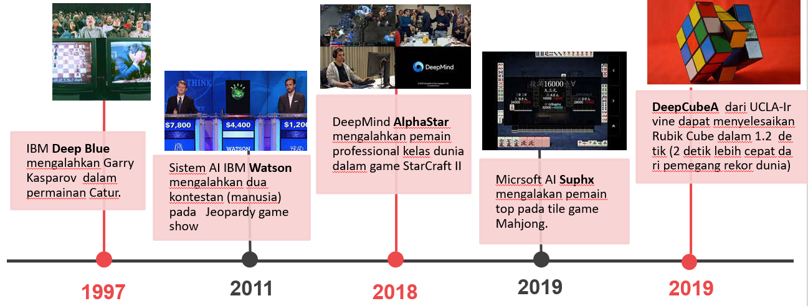
Perkembangan Teknologi AI

Slide 44
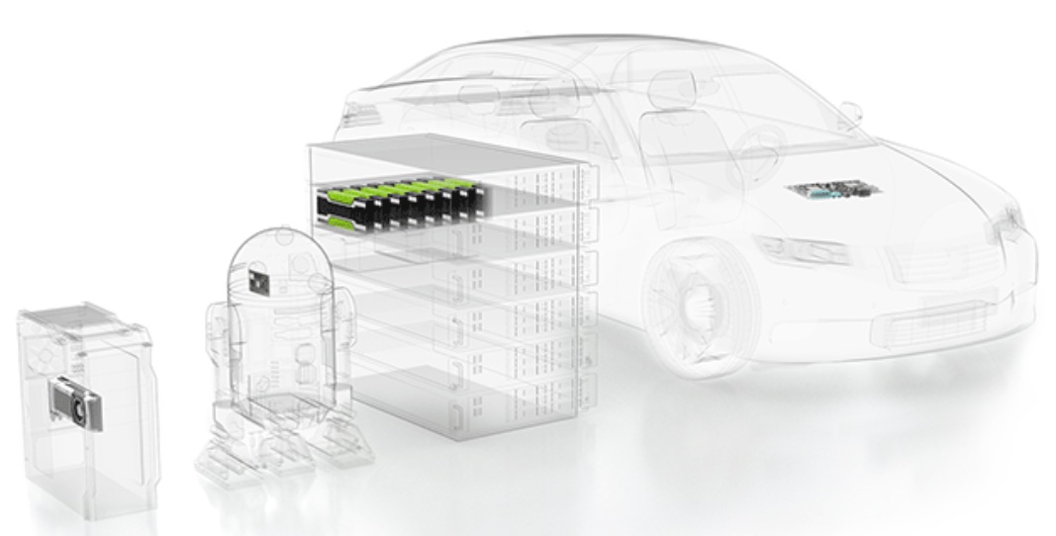
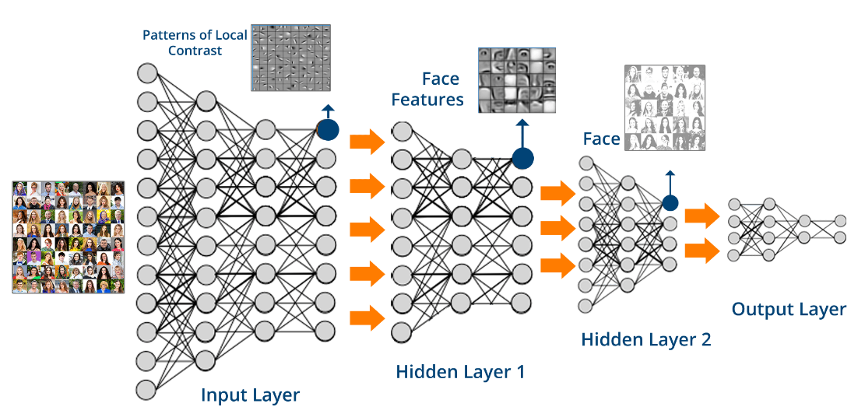
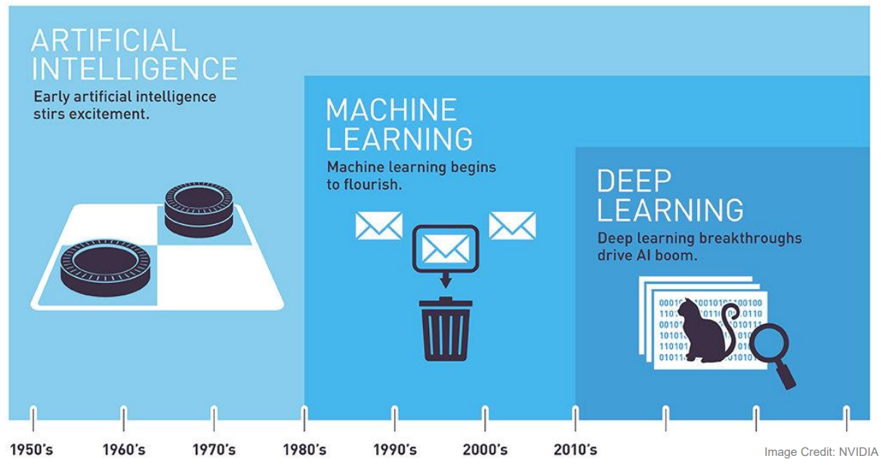
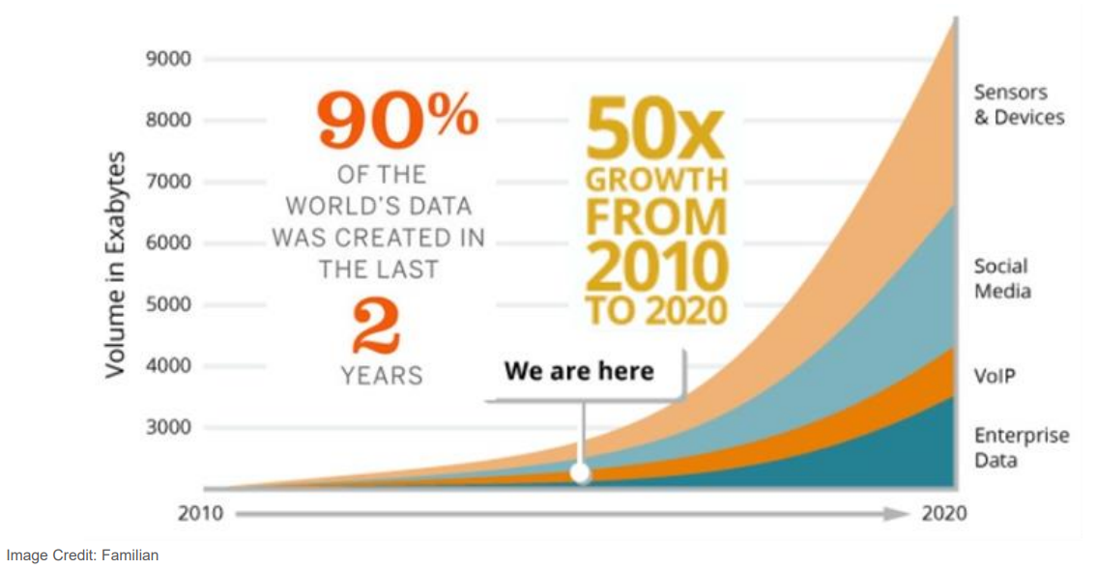
Why Now?
Computing Hardware
GPU,TPU, etc
Cloud
Algorithm
Deep Learning
Data availability
IoT device, Social Media

Slide 45
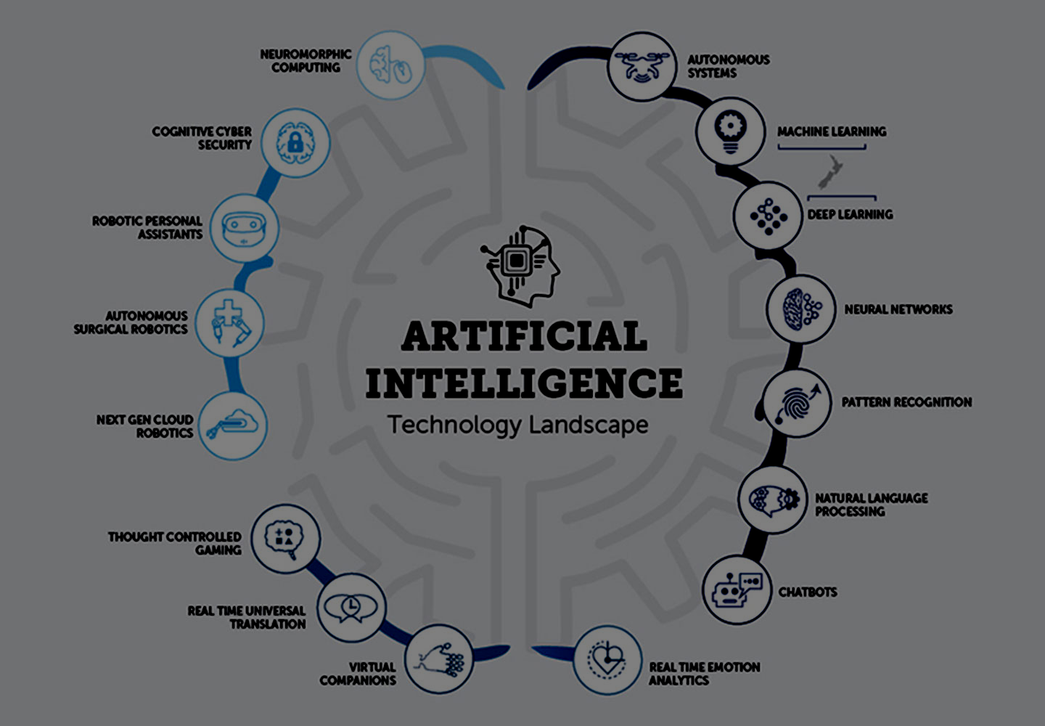
Teknologi AI

Slide 46
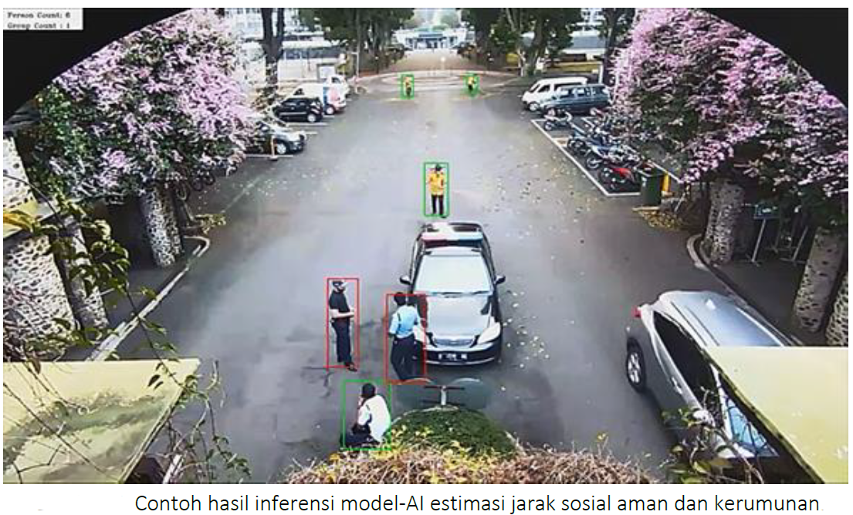
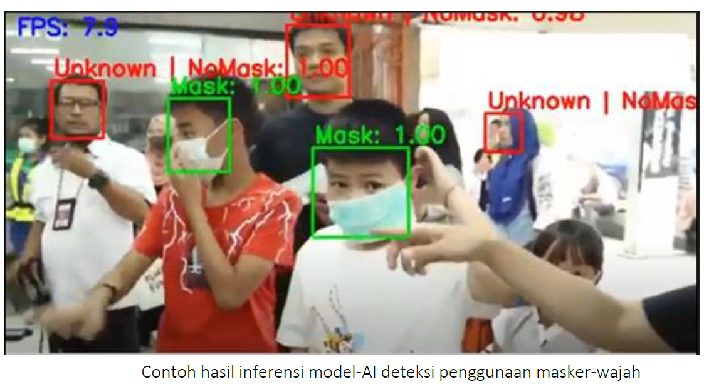
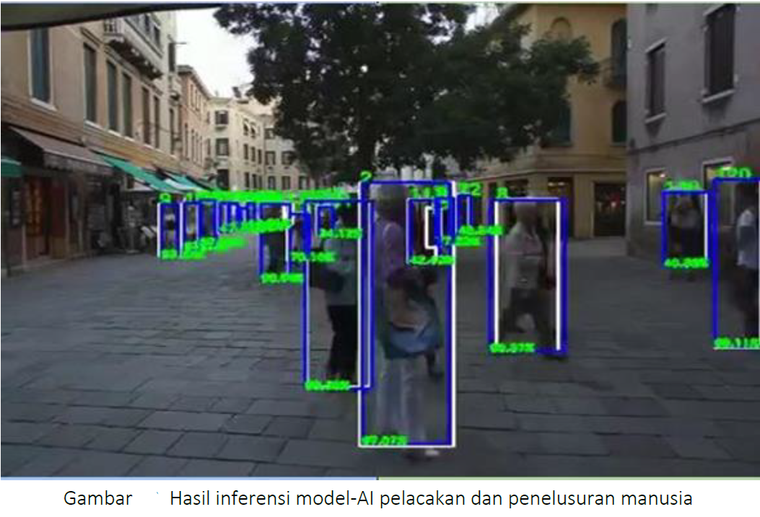
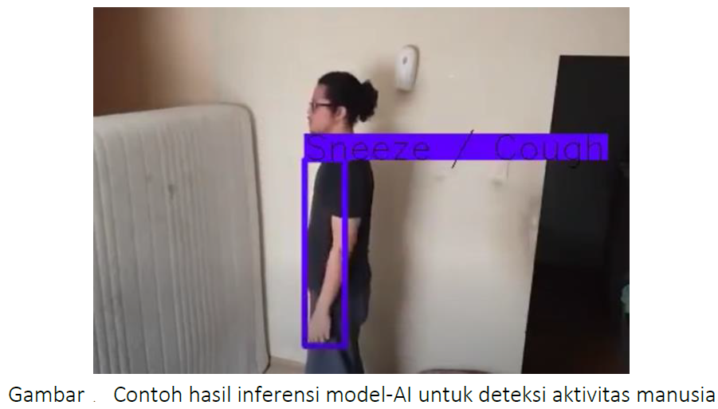
Penerapan AI: Monitoring

Slide 47
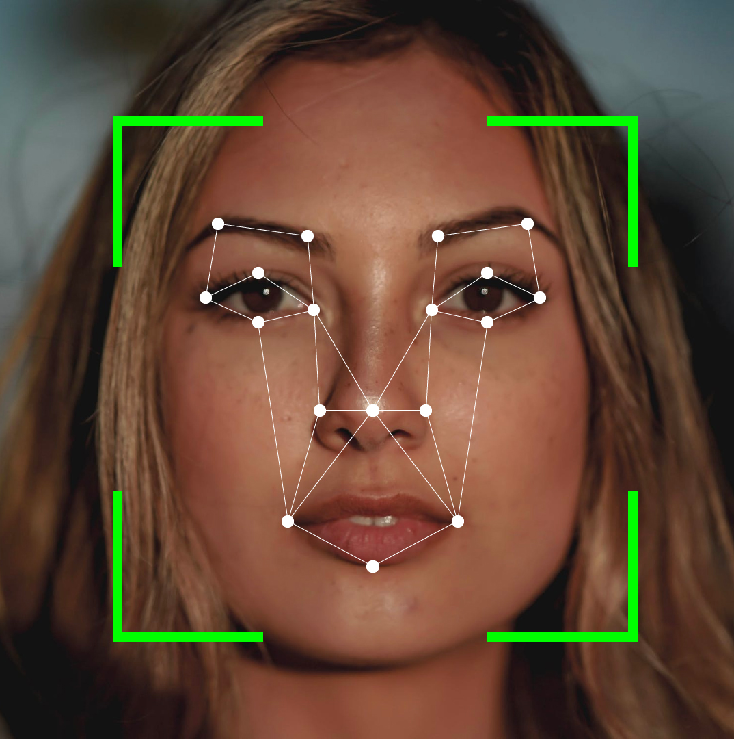






Penerapan AI: Verification & Identification
BENEFITS
Better User Experience (UX) Personalized; Greater Accuracy; Convenient; Frictionless; Fast; Automated Improved Security | Reduce Cost Accessibility: Disabled person (blind, can’t type)
USE CASE SCENARIOS
Electronic-Know Your Customer (eKYC) “Kependudukan & Pencatatan Sipil” (“Dukcapil”) | Verify Login Verify Transactions Customer Service Conversational Analytics
Halo
Voice Biometrics
Faster Authentication
Accurate & Secure
Wide Application
Up to 10 times faster than traditional authentication methods*
Using state-of-the-art AI technology to achieve real-time result with guaranteed high accuracy
47
Applicable to banking, financial services, insurance & healthcare, and other industries
Sumber: prosa.ai

Slide 48
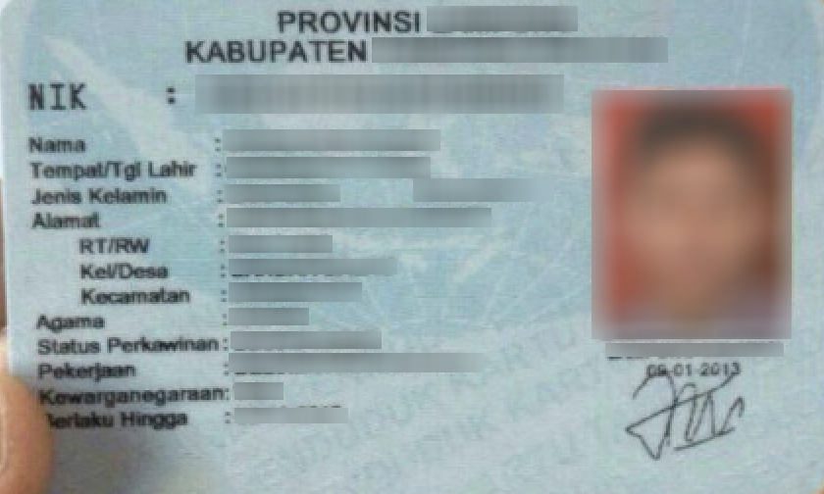
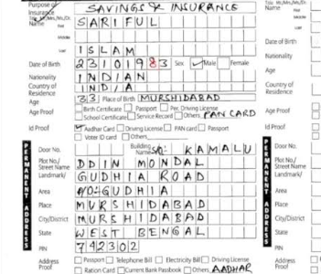


Penerapan AI: Document Digitization
Go paperless. Digitize and secure your past, present and future
BENEFITS
Reduce Clerical Work Faster and Accurate Data Input Reduce Operational Costs Convenience | Automated Improve User Experience Save time Save money
USE CASE SCENARIOS
Electronic-Know Your Customer (eKYC) eKTP, NPWP, Passport, ITAS, ITAP Digitize Invoice and Purchase Orders Credit Card, Birth Certificate, etc | Digitize Documents and Forms Digitize Name Cards Digitize Video/Speech Recording
Voice Recording
Speech
Transcription
Recognition process

Slide 49
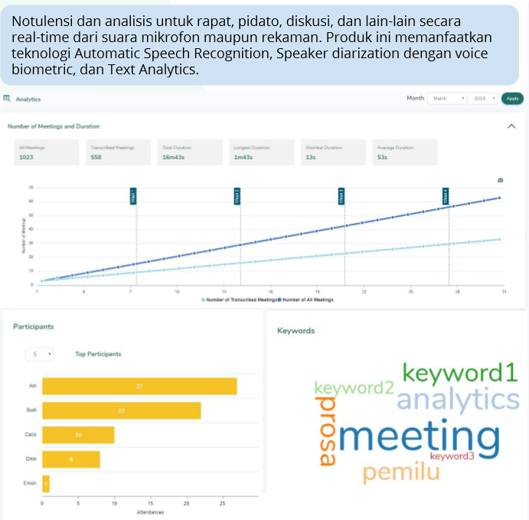
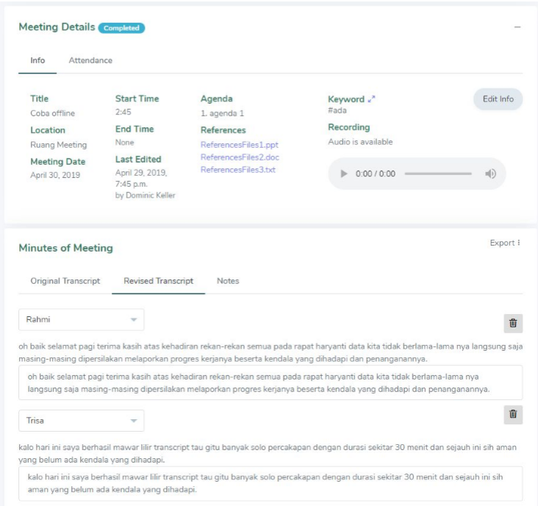
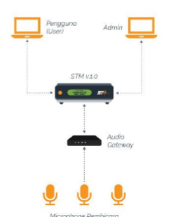
Penerapan AI: Meeting analytics

Slide 50
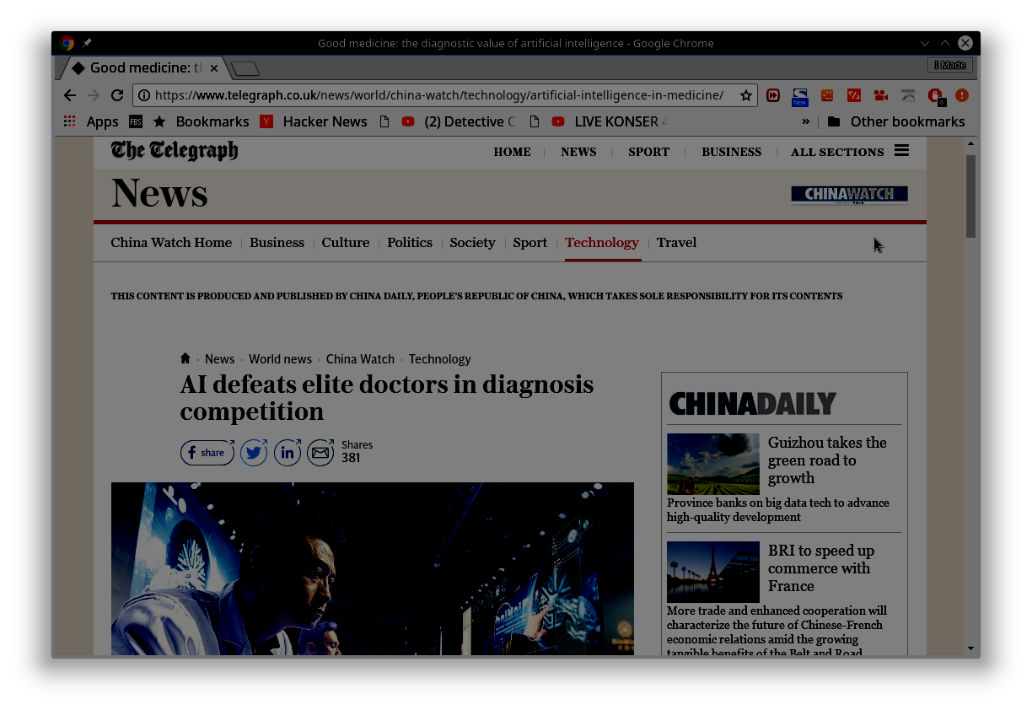




Penerapan AI: Kesehatan
Kombinasi AI dengan image processing, mampu membantu dokter mendeteksi penyakit kulit
BioMind dikembangkan peneliti dari AI Research Centre for Neurological Disorders and Capital Medical University
Mendeteksi dengan ketepatan 87% untuk 225 kasus dalam waktu 15 menit
Tim dokter yang terdiri dari 15 dokter dari RS ternama di China mendapatkan akurasi 66% dalam waktu 30 menit.
Untuk kasus brain ematoma expansion AI 83 % dan dokter 63%

Slide 51





Penerapan AI: eCommerce

Slide 52





Penerapan AI: GeoAI
Super resolution dengan Deep Learning
Blurred
Hi Res
Kombinasi antara Artificial Intelligence (AI) dan Geographic Information System (GIS), pemanfaatan data mining, komputasi berkinerja tinggi digunakan untuk mengekstraksi knowledge dari spatial big data. Meningkatkan pendekatan seleksi pada pola spatial
Banyak digunakan pada kesehatan, lokasi merupakan data terintegrasi dari populasi. Dengan pemanfaatan Internet of Things (IoT) maka memiliki potensi besar di dalam memonitor kesehatan publik
Penggunaan sumber data lain yang dikombinasikan merupakan ciri aplikasi ini, misal aplikasi dari media sosial, electronic health record, remote sensing, sensor perorangan dan perangkat lainnya.
Menilai akurasi prediktif dan kesesuaian teknik permodelan spatial secara independen dan suatu model terintegrasi dari berbagai dataset
Mendapatkan pemahaman dari fungsi spatial yang penting dan memproses sesuai aturan ekstraksi dan penujian faktor sensitifitas

Slide 53







Penerapan AI: Keamanan dan Forensik
Social Interconnection
Criminal Miner
Semantic Link
Complete Time Line
Location Visualization
Event tracking
Timeline matching
Differential Snapshot

Slide 54





Resiko AI : Kesalahan AI
Mobile tak berawak menggunakan beragam sensor, dan data dari berbagai sumber
Tetapi trend mobil tak berawak (driveless car) memiliki risiko
Kesalahan data mengakibatkan dapat mobil bereaksi salah. Beberapa kasus sudah terjadi
Kurangnya training set terkait data untuk melatih AI.
Bila ada kecelakaan SALAH siapa?
Pada saat kondisi macet dan diluar “training set” mobil akan stuck. Bagaimana dengan kondisi kemacetan luar biasa, kondisi perubahan jalanan
AI mulai banyak digunakan untuk menseleksi pegawai, bagaimana bila dari data-training menjadikan AI “rasis”
Bagaimana bila dengan melakukan profiling dapat mengungkapkan beberapa profil “personal” dan dapat digunakan secara tidak benar
Data Ethics dan Ethics pada AI menjadi perlu pertimbangan

Slide 55



Resiko AI : Hilangnya Pekerjaan
“Will a machine take away my job?”
Data driven application
AI based Decision Support
Smart Cyber-Physics

Slide 56
Tantangan dalam Perkembangan AI
Regulasi
Pengaturan etika dan pemakaian AI yang lebih bertanggung-jawab
Privasi
Terkait dengan penggunaan data yang dipakai untuk pembangunan model AI
Kurangnya penjelasan
Bagaimana model AI sampai pada suatu keputusan/kesimpulan tertentu (terkait dengan akuntabilitas dan trust)
Ketersediaan data
Sejauh mana data yang dipakai cukup representative dan tidak bias
Kurangnya Talenta

Slide 57



Fasilitas AI dan Data Science
Collab Lab
Super Computer
EdgeAI
Salah satu tantangan dalam perkembangan AI adalah: ketersediaan talenta SDM, Langkah yang dapat dilakukan dengan mengadakan pelatihan terkait data science, praktikum yang diikuti oleh mahasiswa.

Slide 58
Referensi Video
Introduction to AI
https://www.youtube.com/watch?v=s9vDgPotU-4
https://www.youtube.com/watch?v=wfmM5-d0Zh0
https://www.youtube.com/watch?v=eUpRwSrwbHY
https://www.youtube.com/watch?v=XfEOoAlArXw
https://www.youtube.com/watch?v=uyWHthN3Q9c
Intelligent Agent
https://www.youtube.com/watch?v=XqAUPrLu8_s
https://www.youtube.com/watch?v=ehXgvsl8i_I
https://www.youtube.com/watch?v=NqeVTW4DUuU
https://www.youtube.com/watch?v=btffOHgYsBc
https://www.youtube.com/watch?v=d2608-UCcR8
https://www.youtube.com/watch?v=Spia43l493c
Introduction to Knowledge based Agent
https://www.youtube.com/watch?v=P2DVmc4Zf7I
https://www.youtube.com/watch?v=VhKPNctwInw&t=338s
https://www.youtube.com/watch?v=7iZWC_NtegM
https://www.youtube.com/watch?v=o2alb-eJNqc

Slide 59
Quiz / Tugas
Quiz dapat diakses melalui https://spadadikti.id/
59

